Slide 1
STUDENT RECORD SYSTEM
17/7/2024
SUBMITTED BY,
ADARSH ANOOP NAIR
ROLL NO : 01
COMPUTER SCIENCE DEPT

Slide 2

INTRODUCTION

Slide 3
OVERVIEW
Managing student records is a common requirement in educational institutions. This involves keeping track of student details such as names, roll numbers, marks, and grades. Automating this process through a computerized system can significantly reduce manual effort and errors, ensuring efficient and accurate record-keeping.
PROBLEM STATEMENT
The task is to create a simple C program that allows users to store and manage student records. The program should be able to add new student records, display all student records, and calculate grades based on marks. The system should handle a limited number of students and provide a user-friendly interface to perform these operations.

Slide 4
OBJECTIVE
The main objective of this project is to design and implement a basic student record management system using the C programming language. The system will:
Allow users to add new student records, including name, roll number, and marks.
Automatically calculate the grade based on the marks entered.
Display all stored student records in a readable format.
Ensure that the system is simple, easy to use, and provides accurate information.
By achieving these objectives, the program will serve as a foundational tool for understanding basic data structures, file handling, and user interaction in C programming.

Slide 5
SYSTEM REQUIREMENTS
Hardware Requirements
Processor: Intel Pentium 4 or higher
Memory (RAM): 512 MB minimum, 2 GB recommended
Storage: 50 MB free disk space
Display: 800x600 resolution minimum
Input Devices: Keyboard
Output Devices: Monitor
Software Requirements
Operating System: Windows XP or higher, Linux, or macOS
Compiler: GCC, MinGW, or any compatible C compiler
IDE/Text Editor: Code::Blocks, Dev-C++, Visual Studio Code, or any text editor
Libraries: Standard C library (stdio.h, string.h, stdlib.h)
Documentation: Access to C language documentation

Slide 6
DESIGN AND DEVELOPMENT

Slide 7
DESCRIPTION OF PROGRAM LOGIC
Initialization
Define a structure Student for student details.
Initialize an array students to hold student records.
Start with count set to 0 for tracking stored students.
Menu Interaction
Display a menu with options: add student, display students, or exit.
Prompt the user for their choice and read input.
Add Student:
Check if there's space in the students array (count < MAX_STUDENTS).
Prompt for name, roll number, and marks.
Calculate the grade based on marks and store the student's details.
Increment count and confirm successful addition.
Display Students:
Check if any students are stored (count > 0).
Print details (name, roll number, marks, grade) for each student.
Exit Program
End the program when the user chooses to exit.

Slide 8

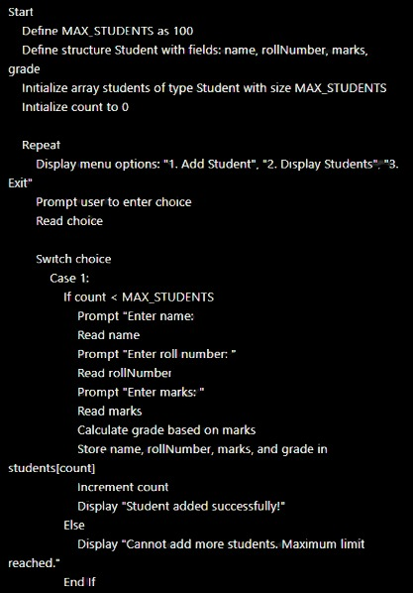
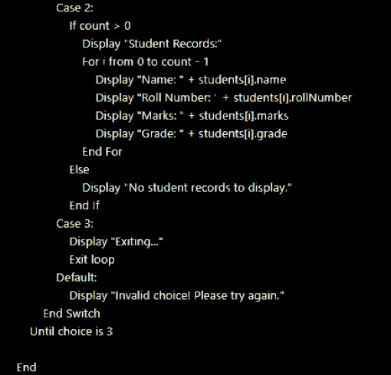
PSUEDOCODE

Slide 9
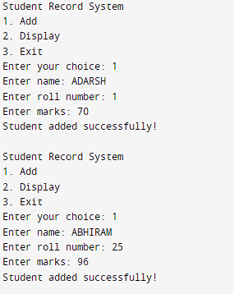
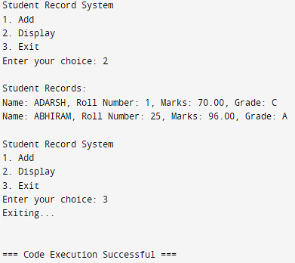
RESULT

Slide 10
SUMMARY
Managing student records in C involves using structures to organize information such as name, roll number, marks, and grade. Each student's data is stored in a struct Student, facilitating operations like adding new records and displaying existing ones. The program interacts with users through a simple menu system, enabling tasks such as inputting student details, computing grades based on marks, and presenting records. This approach illustrates fundamental concepts of data structuring and user interaction in C programming, providing a clear foundation for beginners learning about data management in software development.

Slide 11
FUTURE ENHANCEMENT
File Saving: Implement saving student data to a file.
Search & Update: Allow searching and updating student records.
Sorting: Add sorting options for student records.
Error Handling: Improve handling of user input errors.
Basic GUI: Create a basic graphical interface for easier interaction.
Database Use: Integrate a database for storing student information.
Analytics: Include basic analytics like average marks.
Cross-Platform: Ensure the program works on different operating systems.
Language Support: Support multiple languages for user interface.
Security: Implement basic login for access control.

Slide 12
THANKYOU

